Slide 1
TEAM-9 : SYLLABUS PREPARATION MANAGEMENT SYSTEM
Ost pROJECT

Slide 2
TEAM MEMBERS
R.NAGASAI 318126510104
K.SAMPATH 318126510106
Y.HANISH 318126510112

Slide 3
ABSTRACT
The Purpose of the Syllabus Preparation Management is to automate the process of maintaining the syllabus preparation process,from the start to the end,to some extent
Our project solely concentrates on the faculty Of CSE Department,ANITS
There has been a practice of doing the syllabus preparation manually by the Syllabus Coordinator,who manages the interactions between preparators and collecting reviews from reviewers.We had an idea to automate this process online by using the Syllabus Preparation Management System as a part of our OST mini lab project
With the help of our project,it will be easier to manage two or more syllabus preparation at the same time without much burden on Syllabus Coordinator

Slide 4
INTRODUCTION
Syllabus Preparation Management System is designed to automate the process of syllabus preparation to some extent and to simplify the tedious task of managing the processes of 2 or more syllabus preparations at the same time
The admin(Syllabus Coordinator) simply needs to give necessary information of concerned subject at the start and the process will be automated from there,to the completion of the preparation,by our system.
The admin can check the status of the various processes and keep track of them
By the use of this system it is possible for multitasking various syllabus preparations simultaneously

Slide 5
WORKING
At start the database coordinator of the CSE department creates accounts for each and every faculty of CSE in the database of the system and makes the Syllabus Coordinator as admin
There are two kinds of logins for the system but they share the same login page.They are:
Admin Login : For The Admin or the Syllabus coordinator
Faculty Login : For the Rest of the CSE Faculty
In the case if any member forgets their password they can get their password by mail using Forgot Password
At the starting,the admin starts the syllabus preparation by giving necessary details of the Subject Like Regulation,Semester,Name with proposed faculty names as preparators and Reviewers
The system then generates a subject code for the subject and alerts the preparators by mail and sending Subject Code

Slide 6
WORKING
Then the three preparators can prepare syllabus together in offline and make it as pdf.After this,any one of them can login to system with their credentials and upload the pdf
After they upload the pdf,the system immediately alerts the reviewers by sending a mail with the subject code and uploaded pdf as a attachment
The reviewers browse through the pdf.They,then,login to the system and give their reviews about the syllabus pdf
Then,automatically after all reviews are given,the preparators will again be alerted by mail that reviews were given and check them in the website.
After checking the reviews and modifying the syllabus pdf,if necessary,the preparators will upload the final second pdf.Admin will be notified that final syllabus pdf has been uploaded and will be sent an pdf attachment by mail.Then, Admin will check it and end the syllabus if okay.
Admin can check the progress of preparation and can see completed syllabus in Archives

Slide 7
WEBPAGES SCREENSHOTS

Slide 8
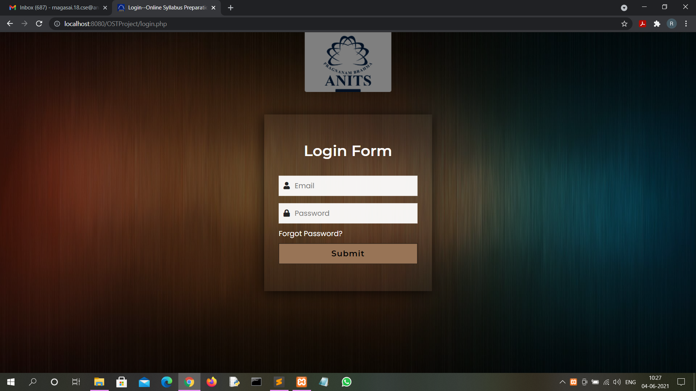

Slide 9
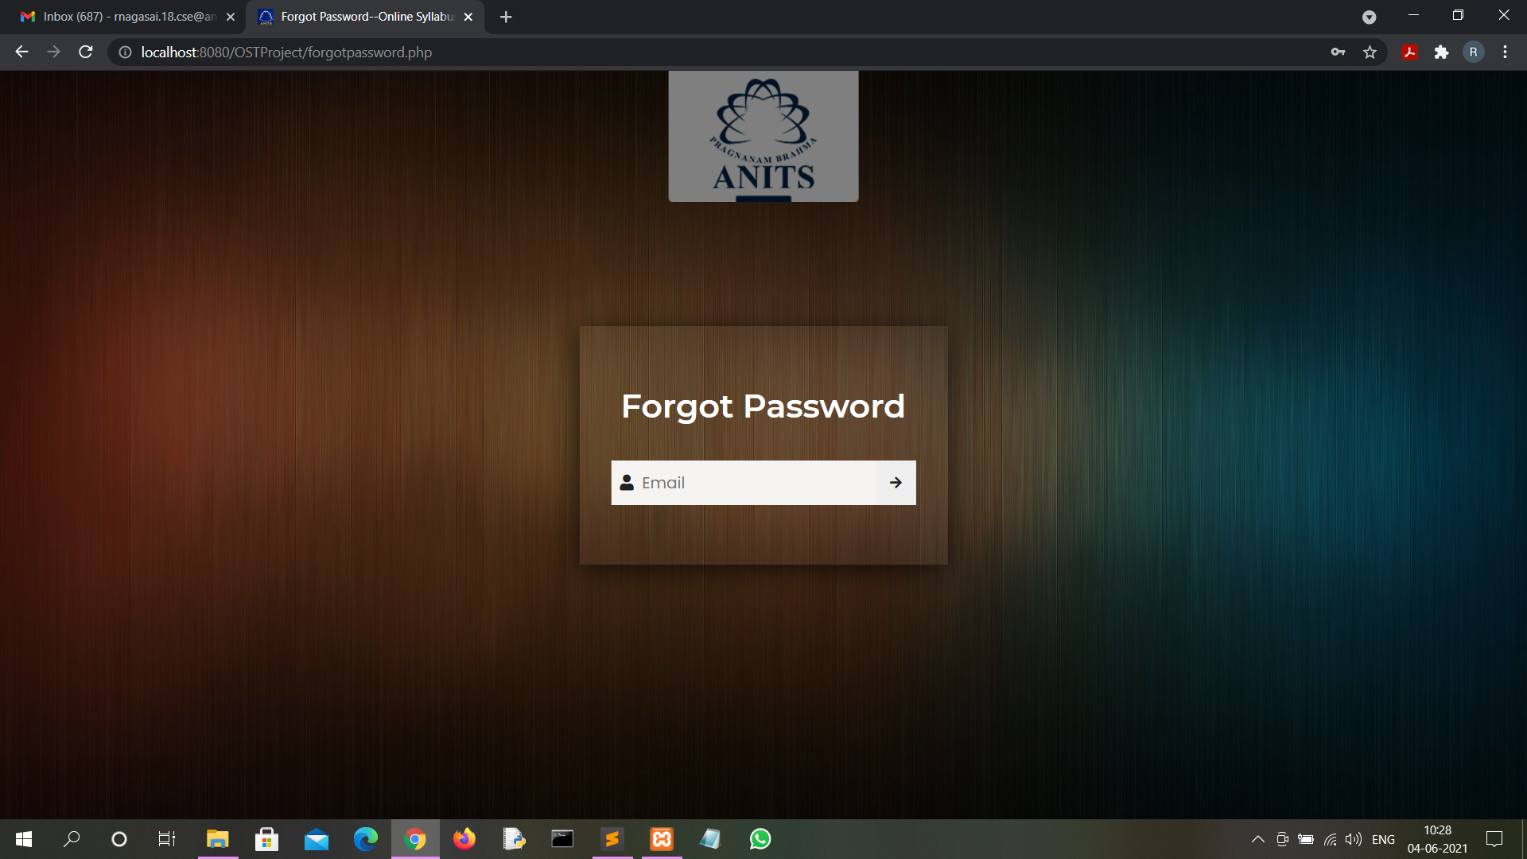

Slide 10
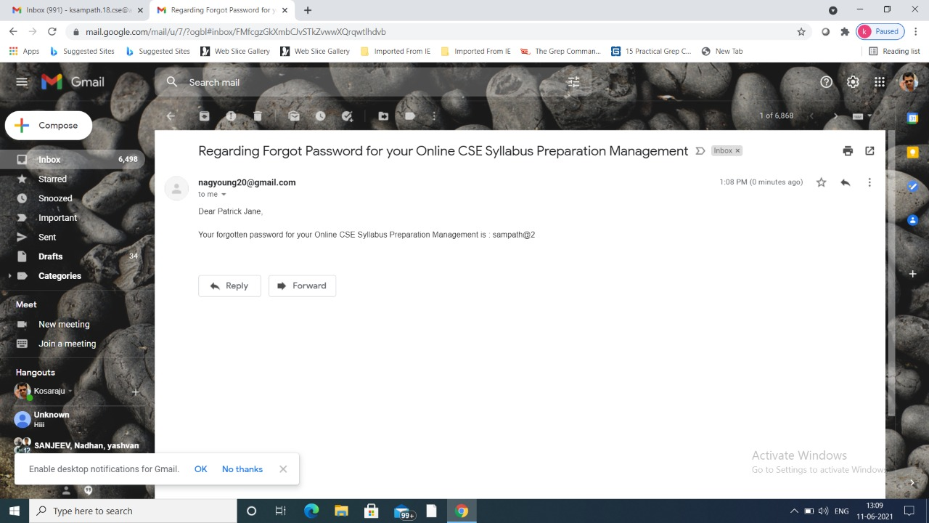

Slide 11
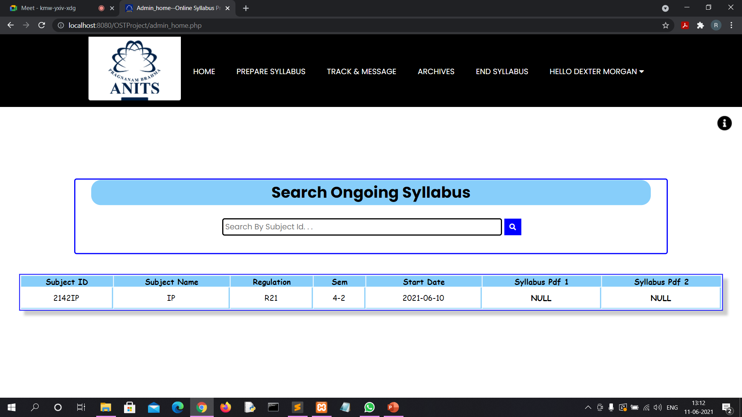

Slide 12
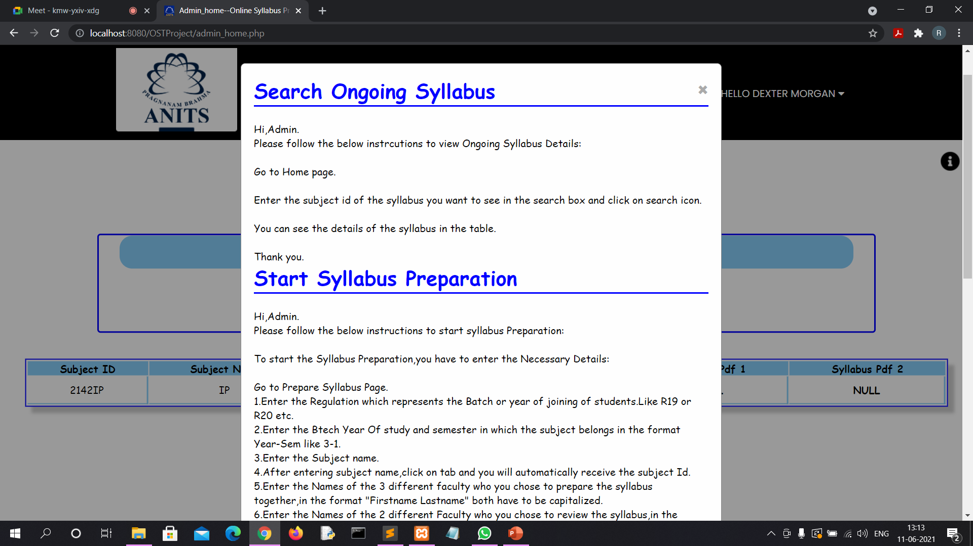

Slide 13
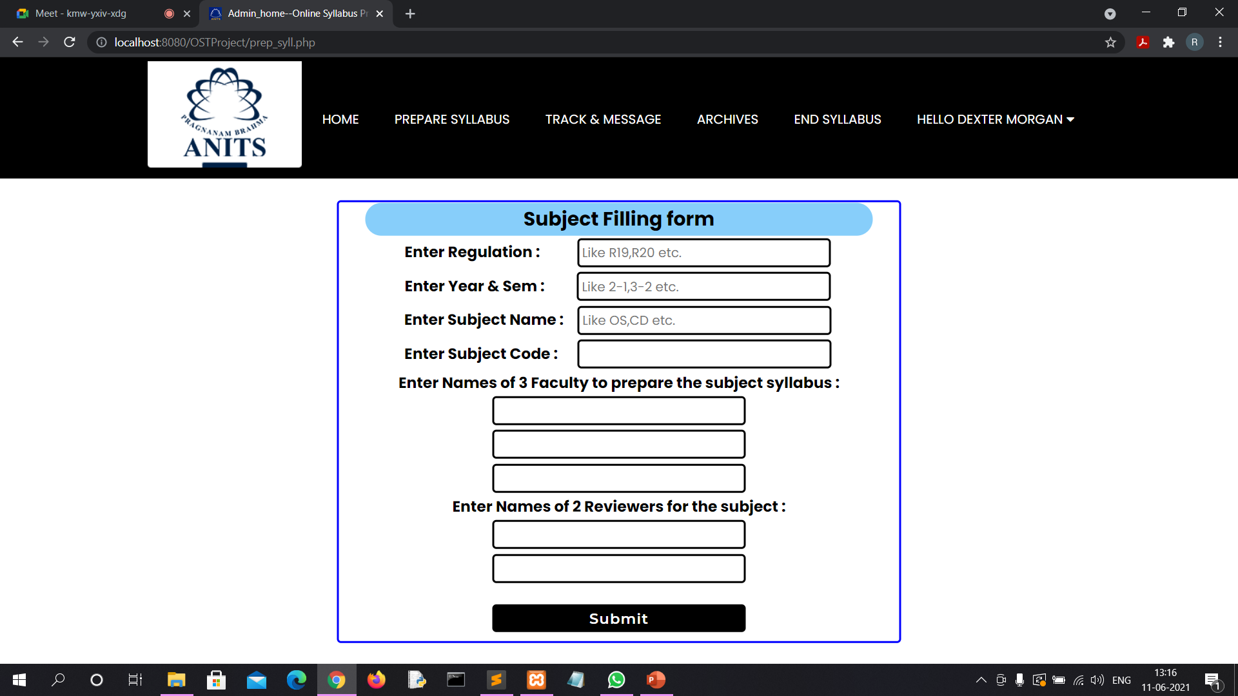

Slide 14
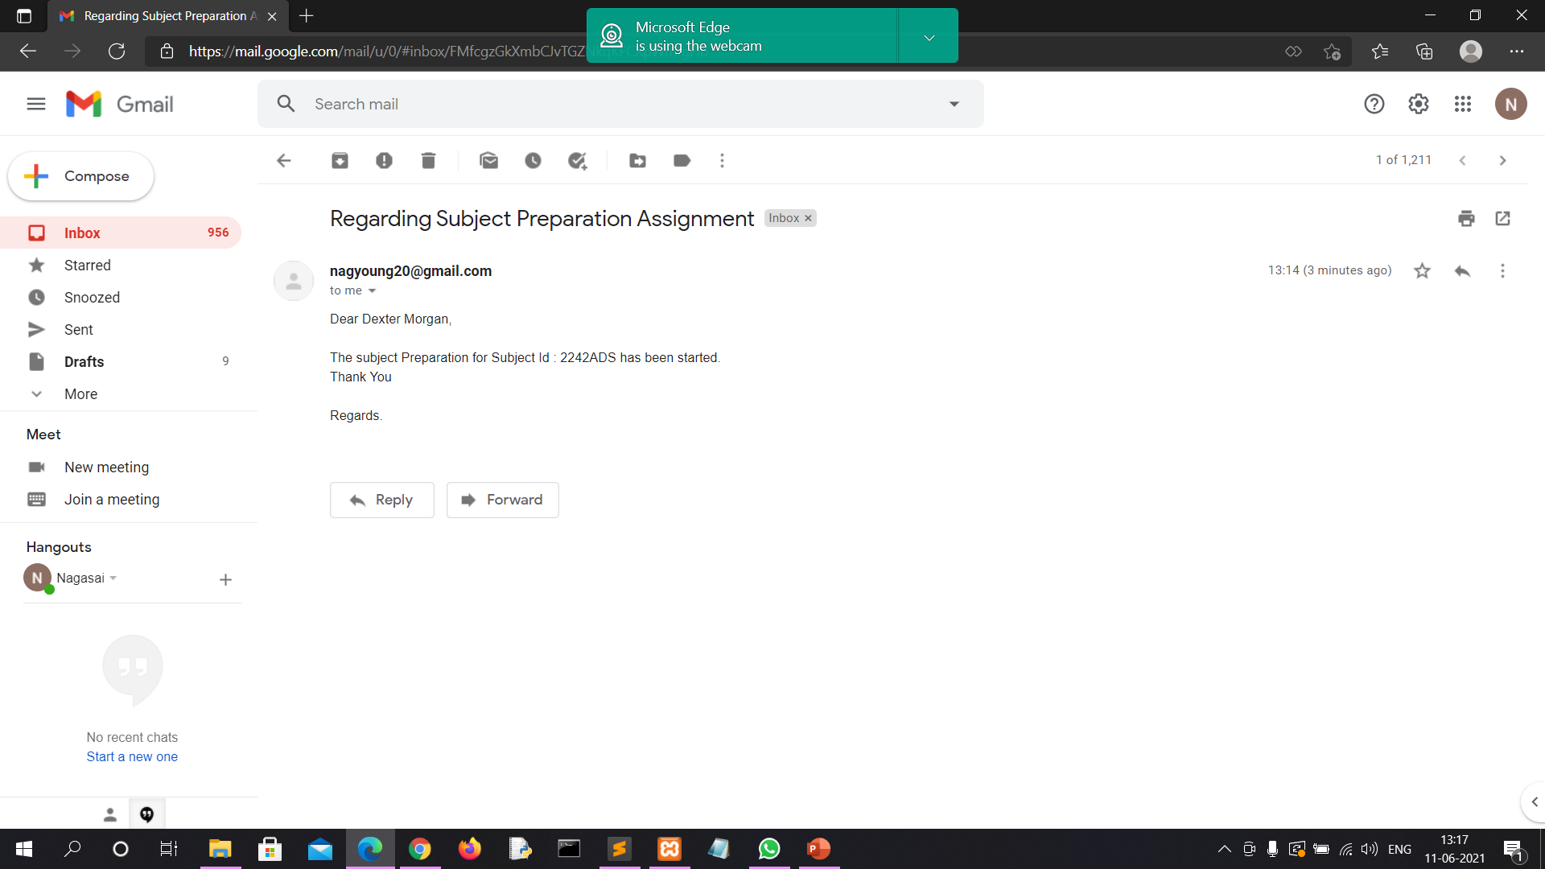

Slide 15
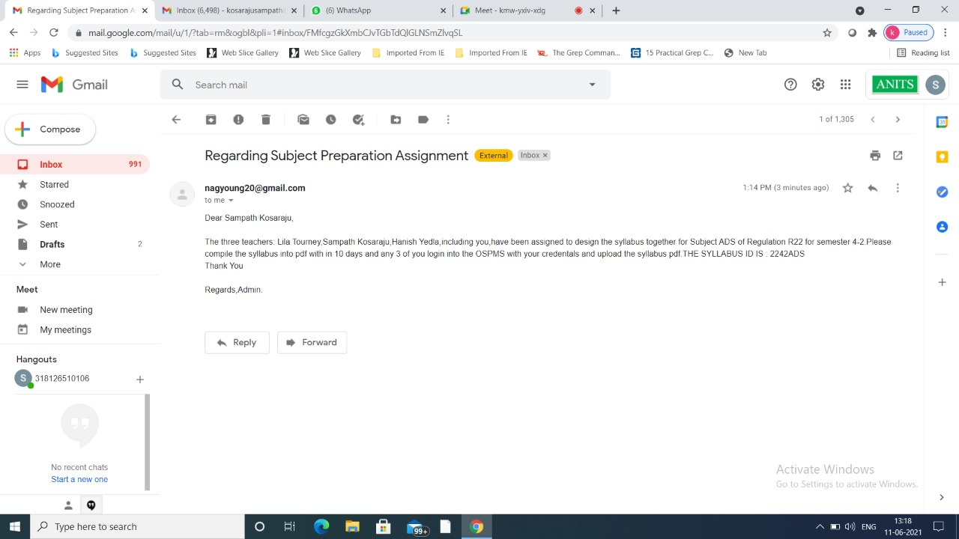

Slide 16
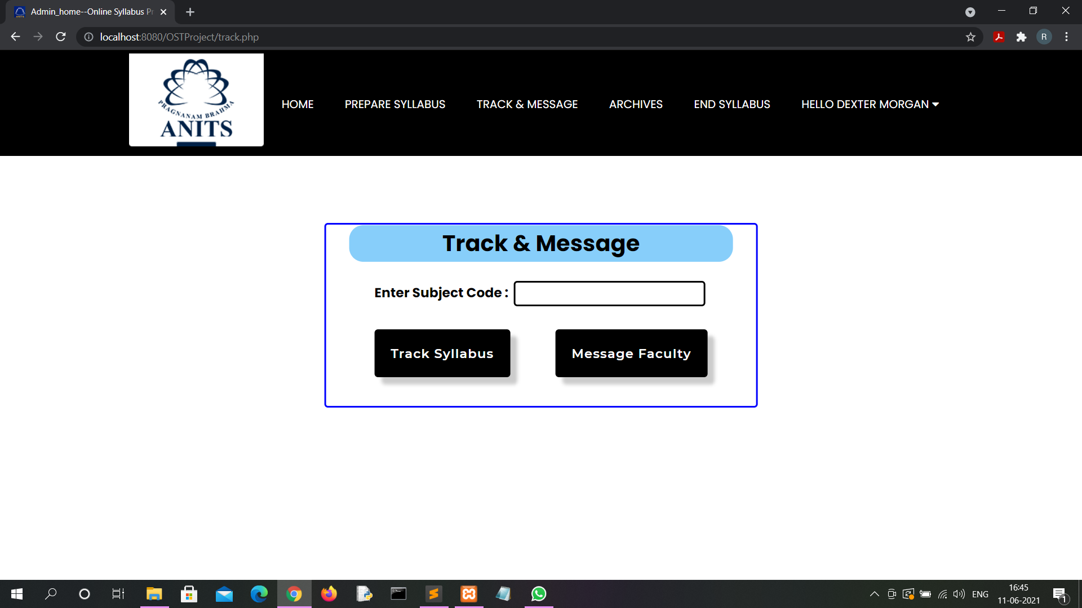

Slide 17
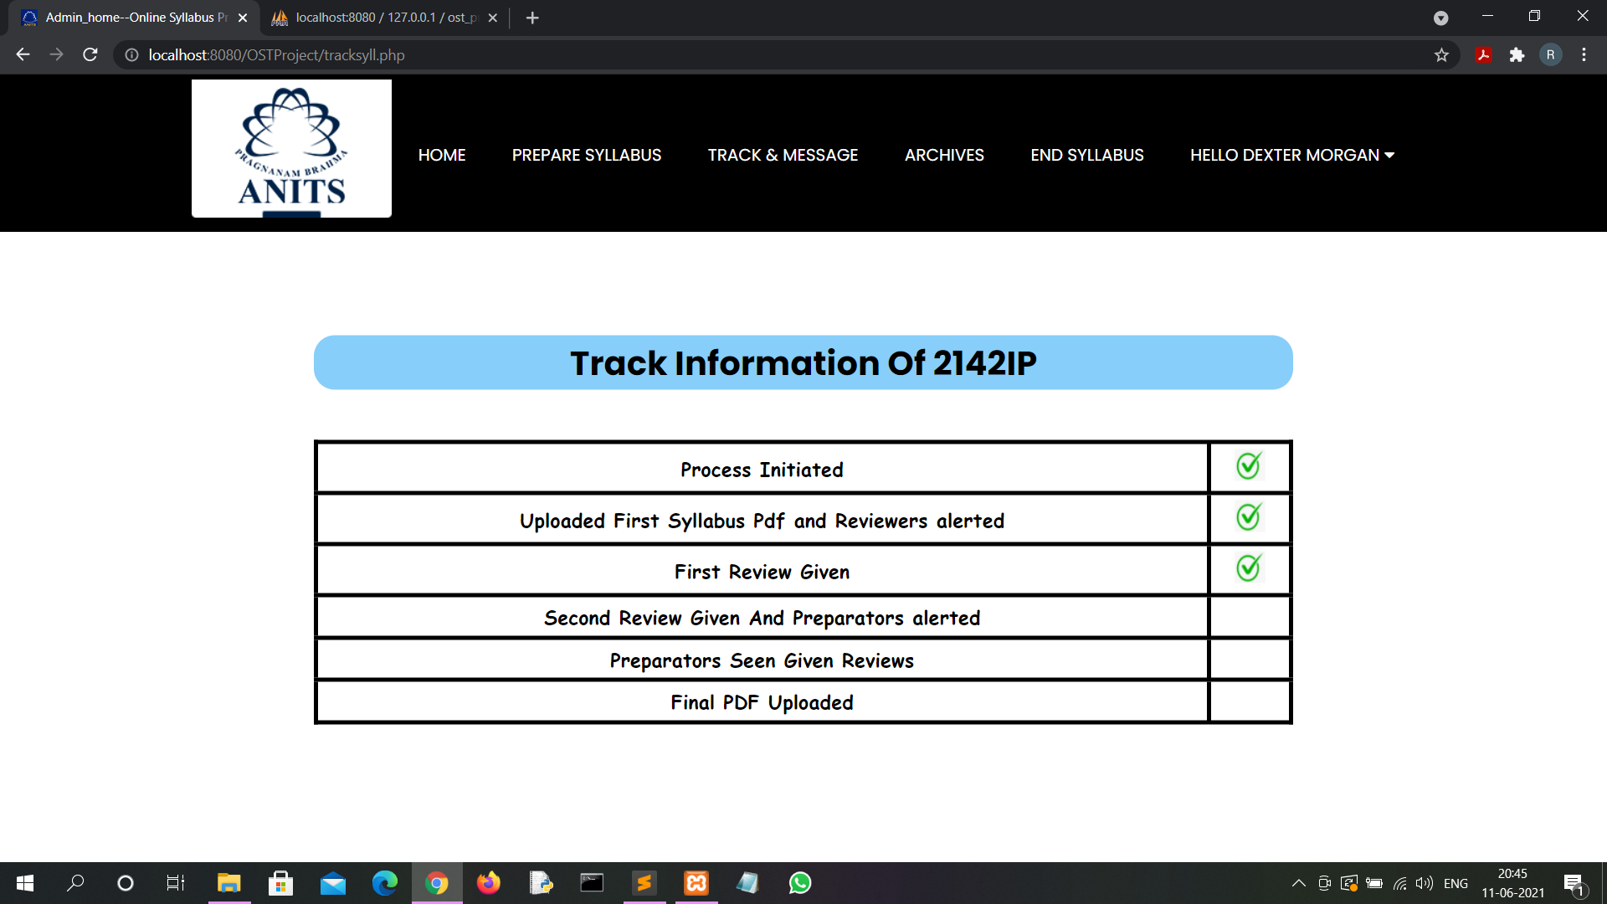

Slide 18
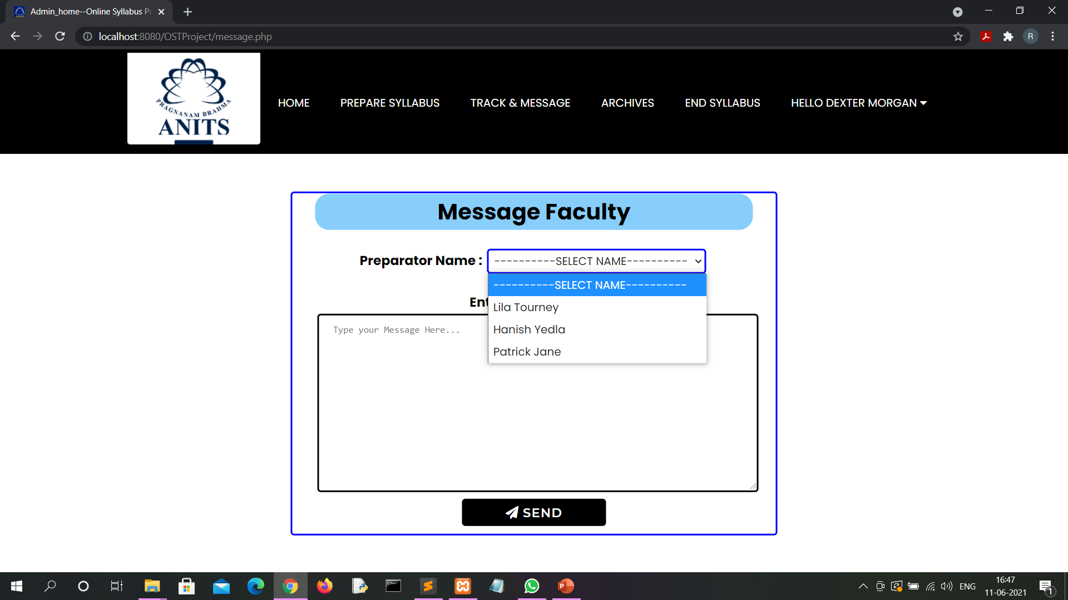

Slide 19
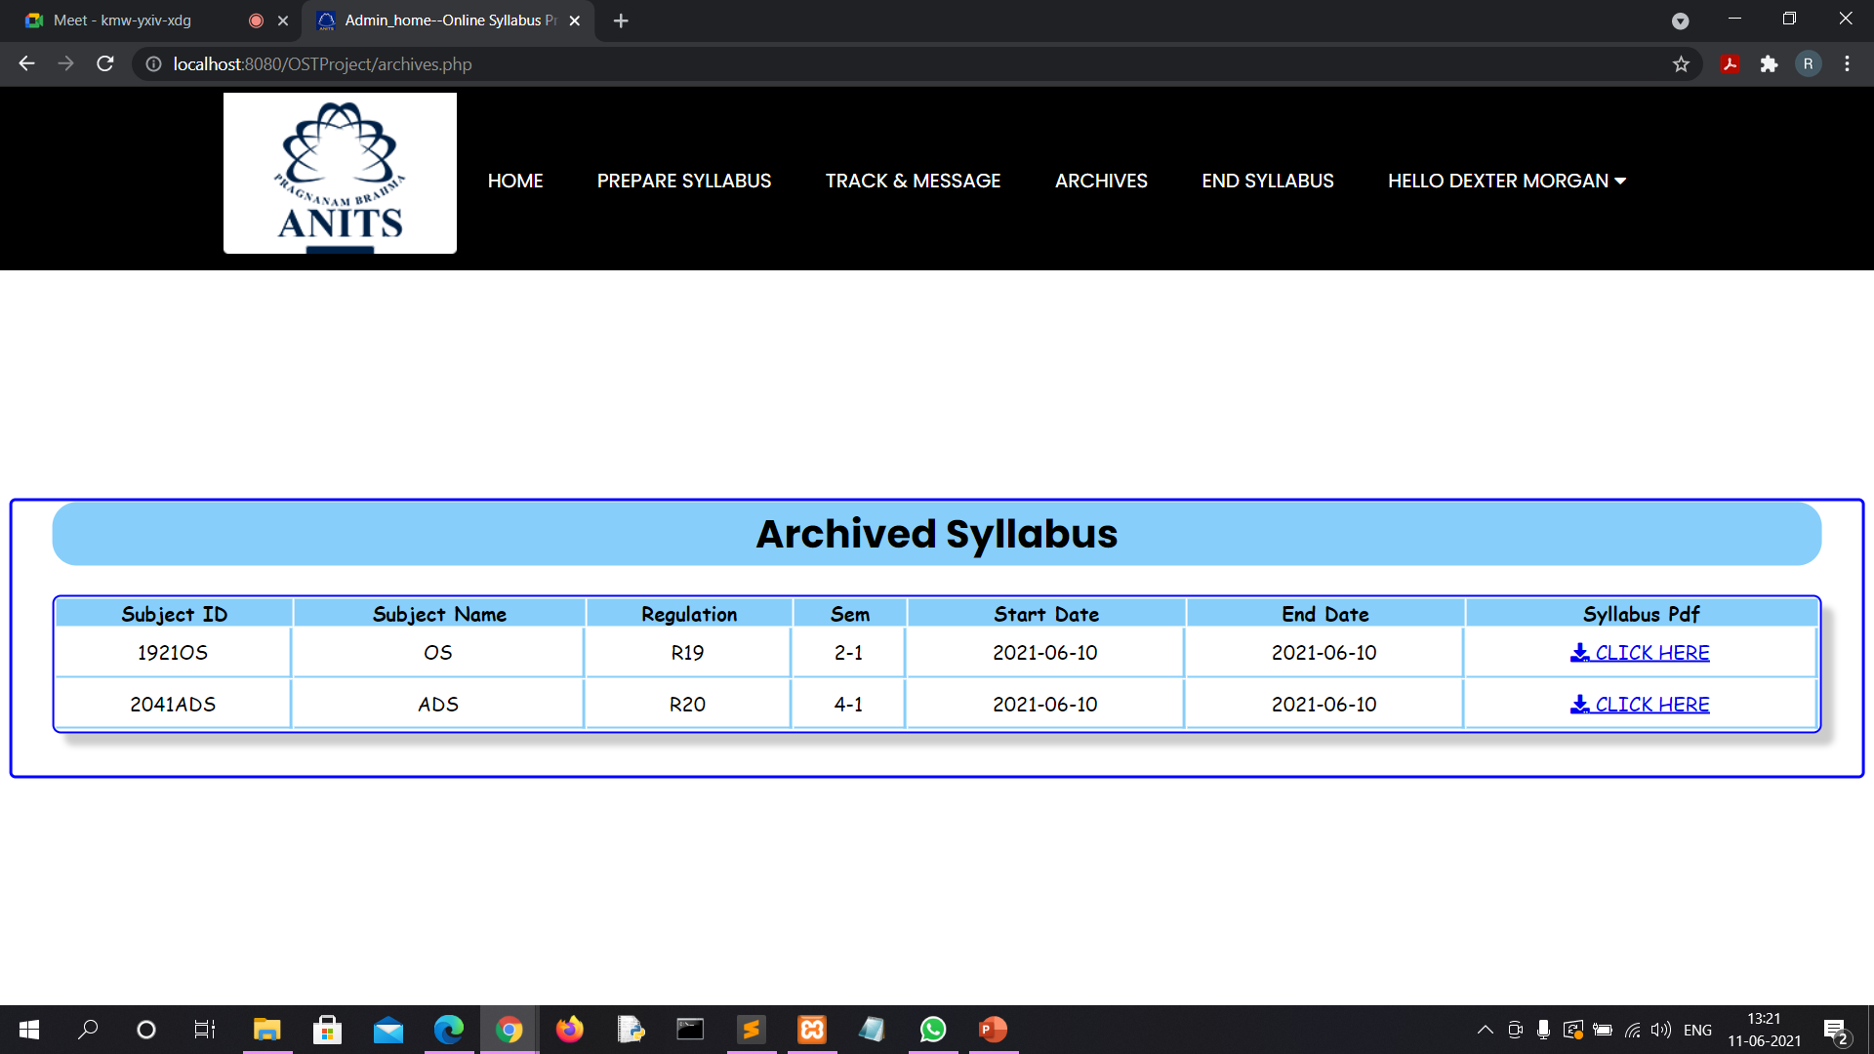

Slide 20
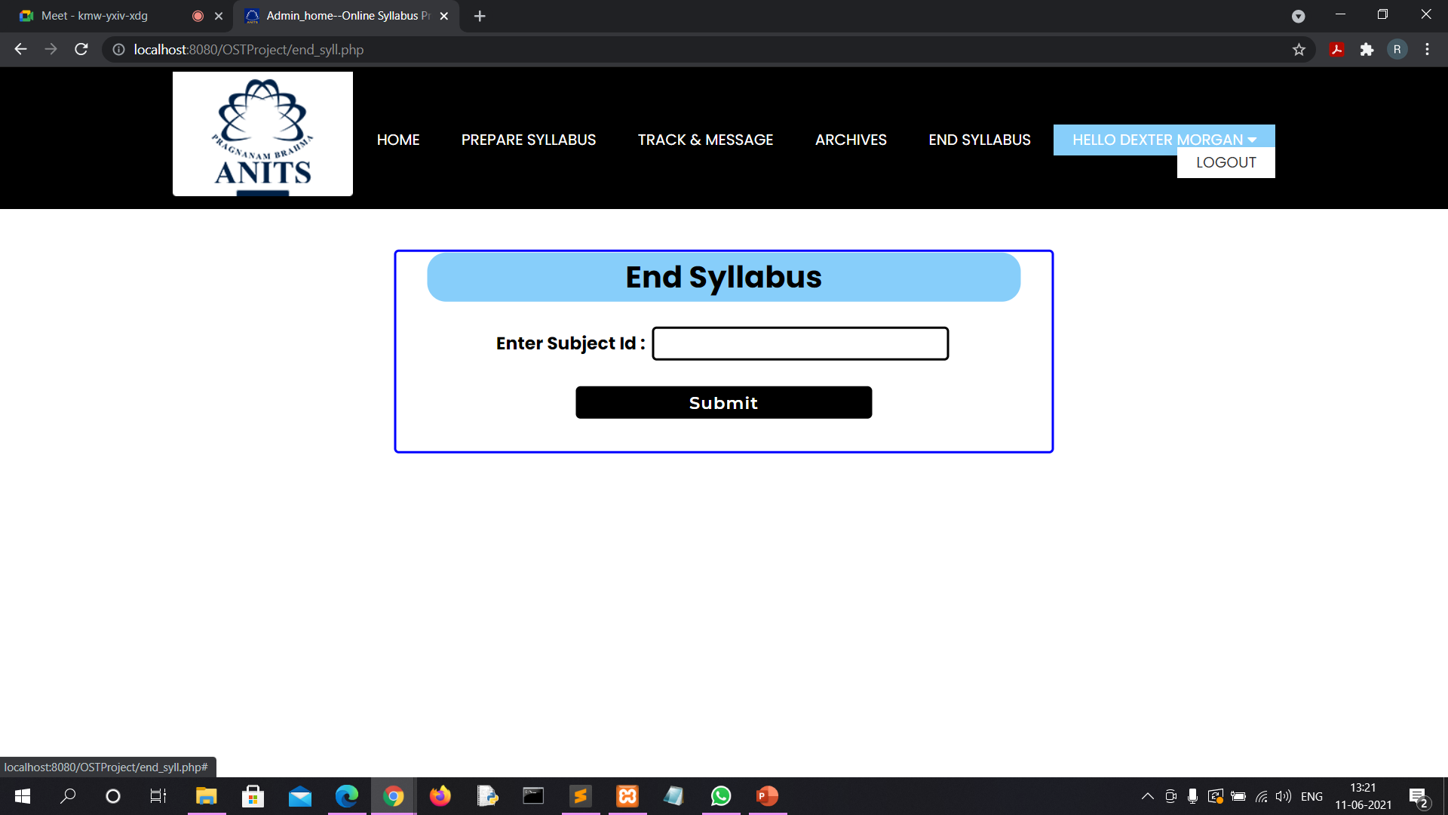

Slide 21


Slide 22
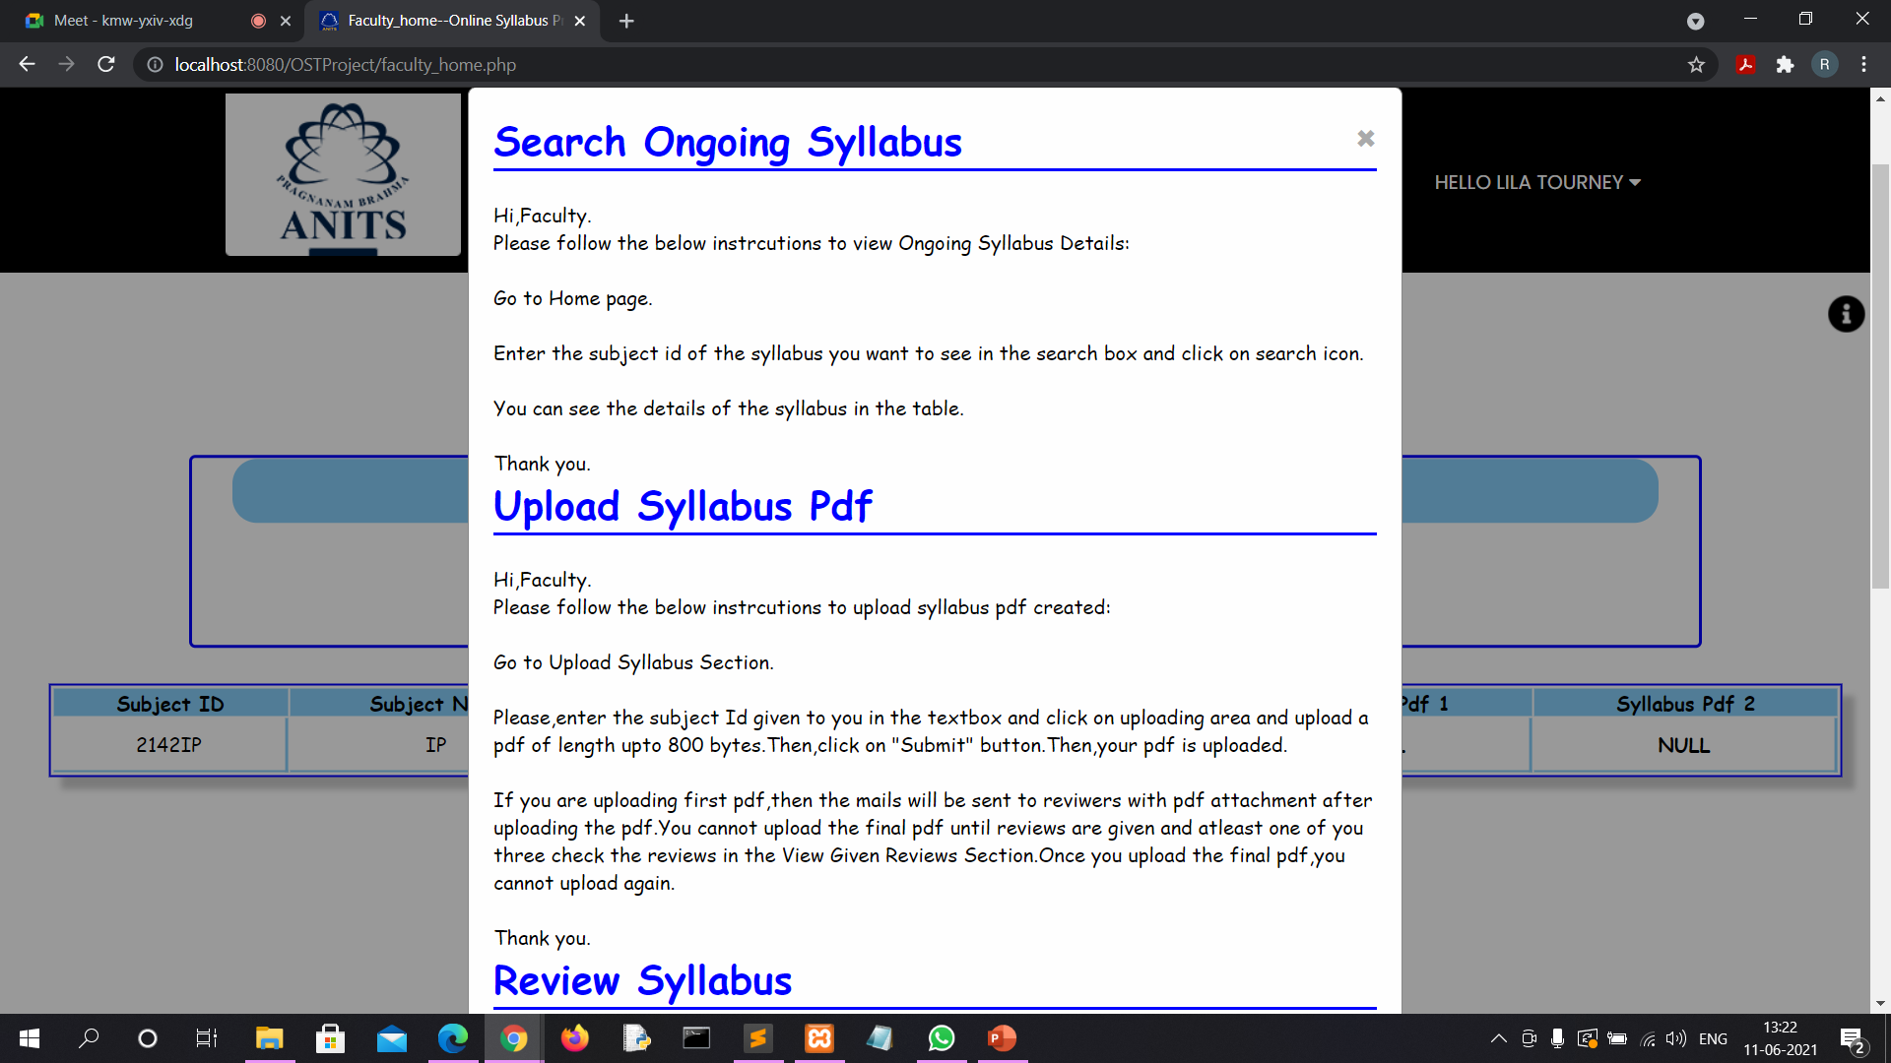

Slide 23
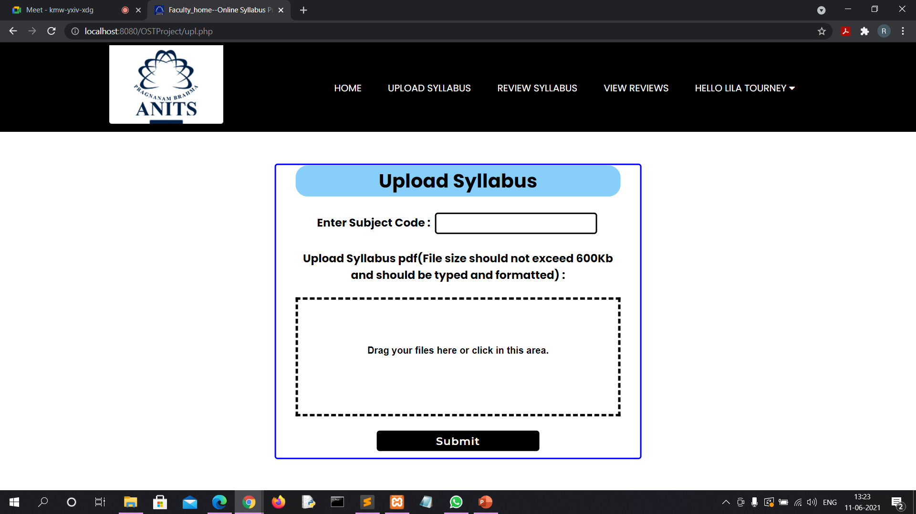

Slide 24
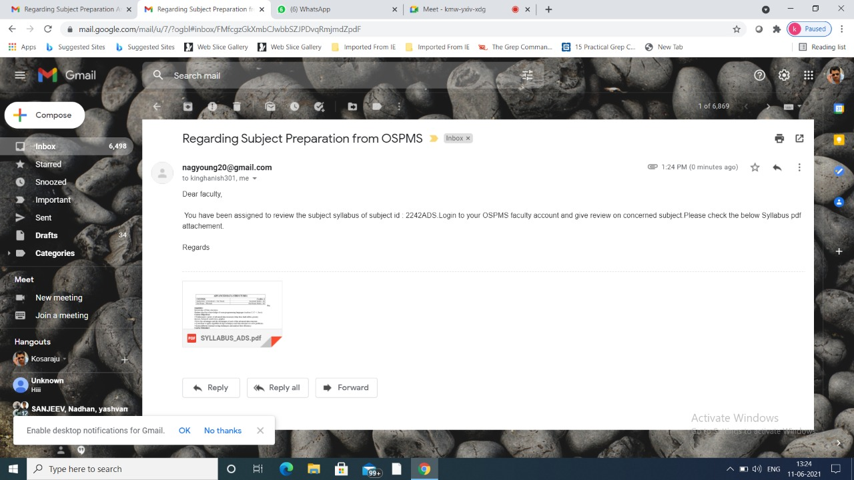

Slide 25
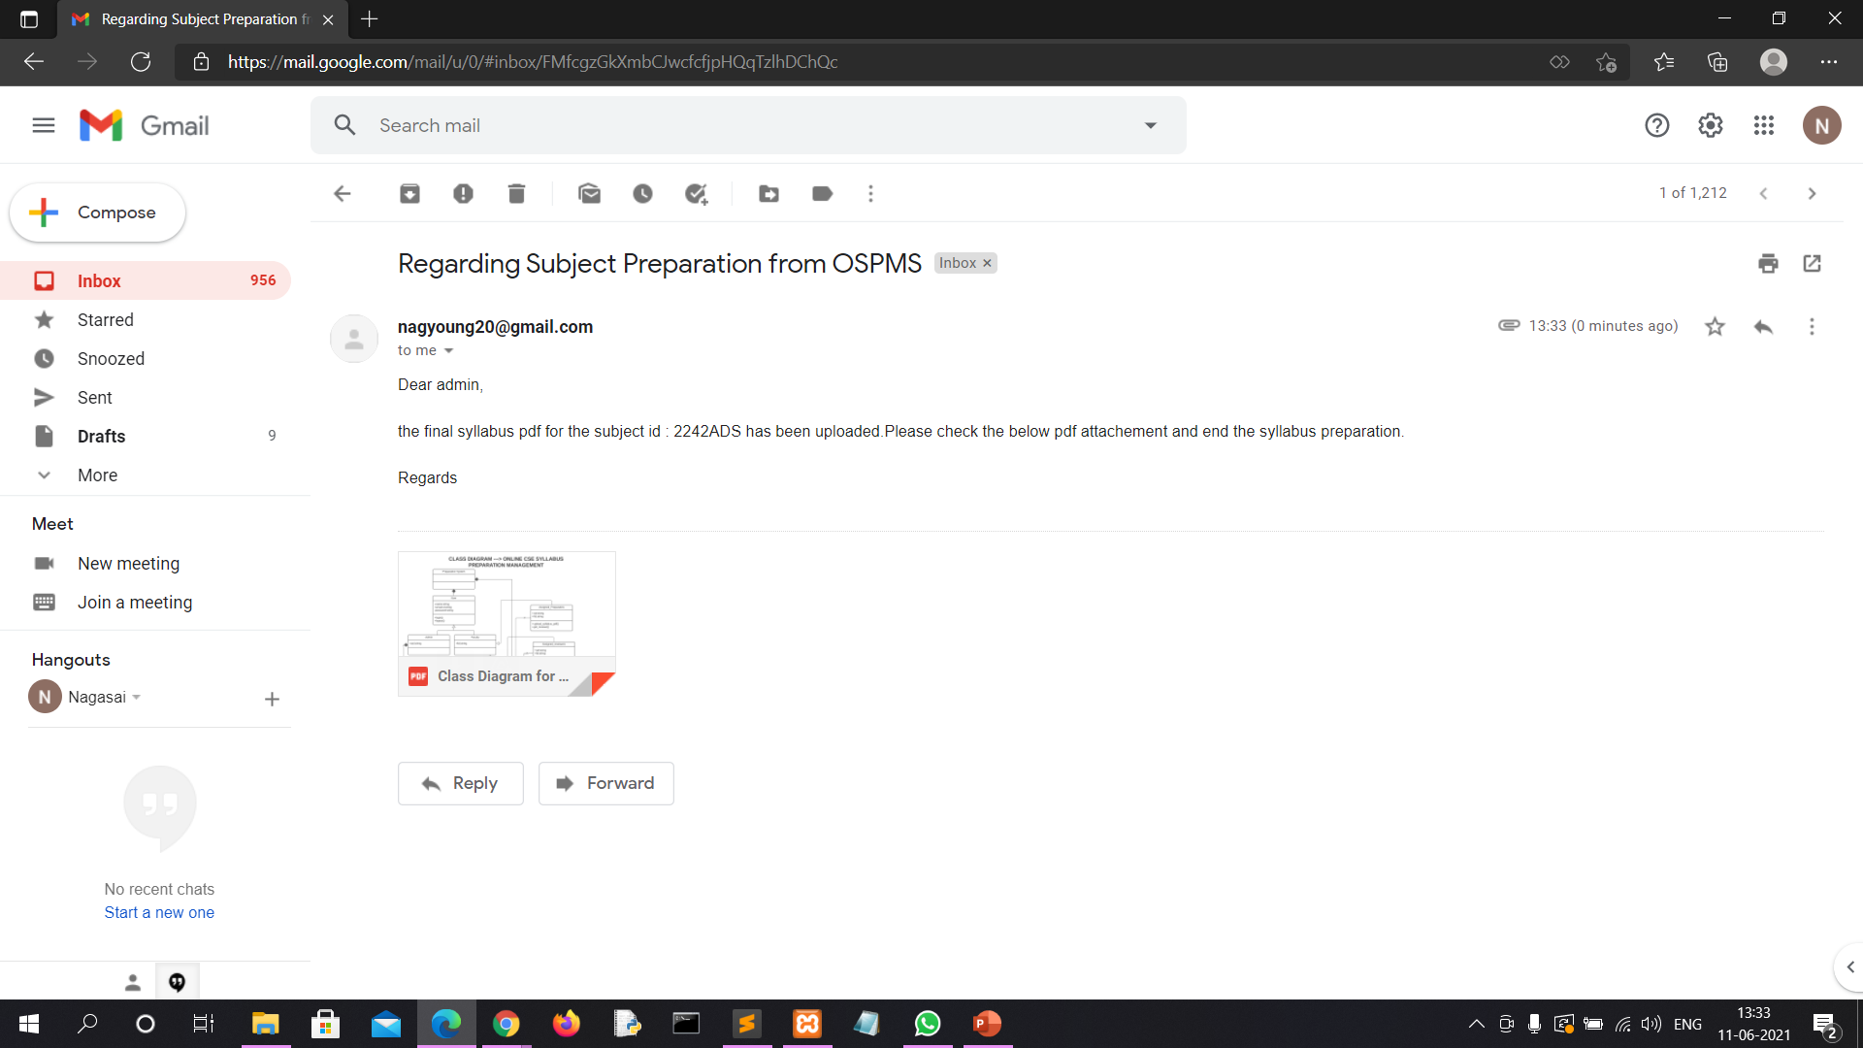

Slide 26
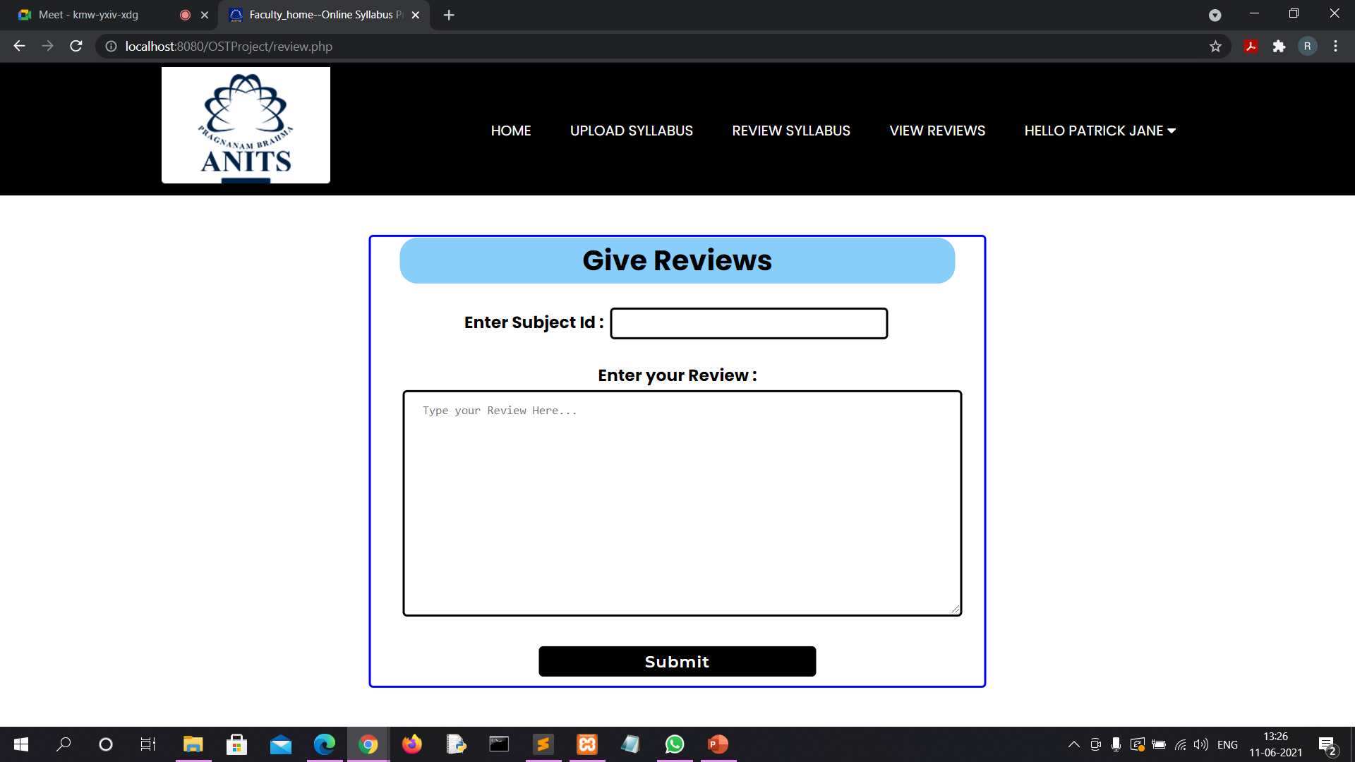

Slide 27
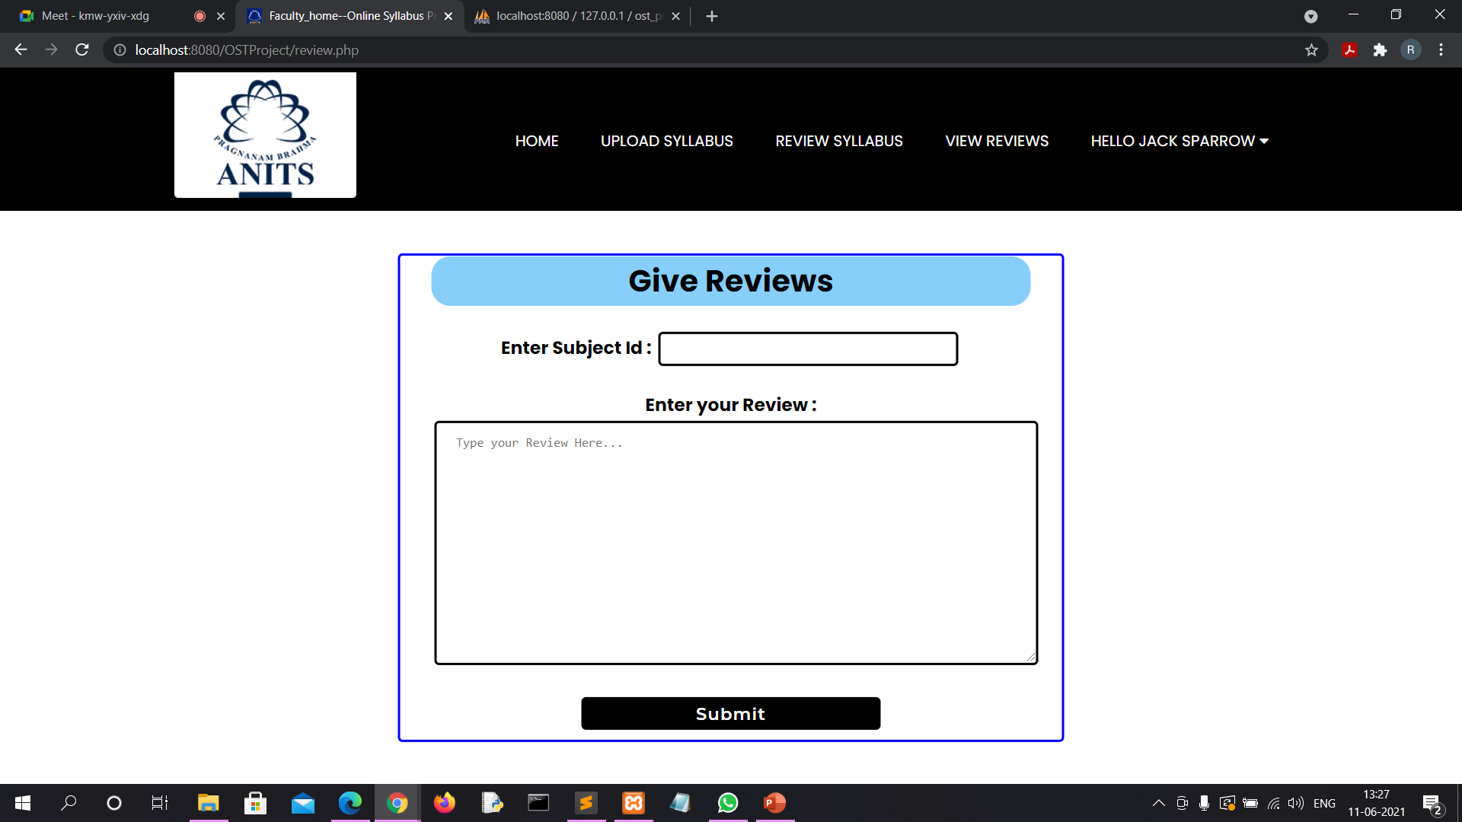

Slide 28


Slide 29
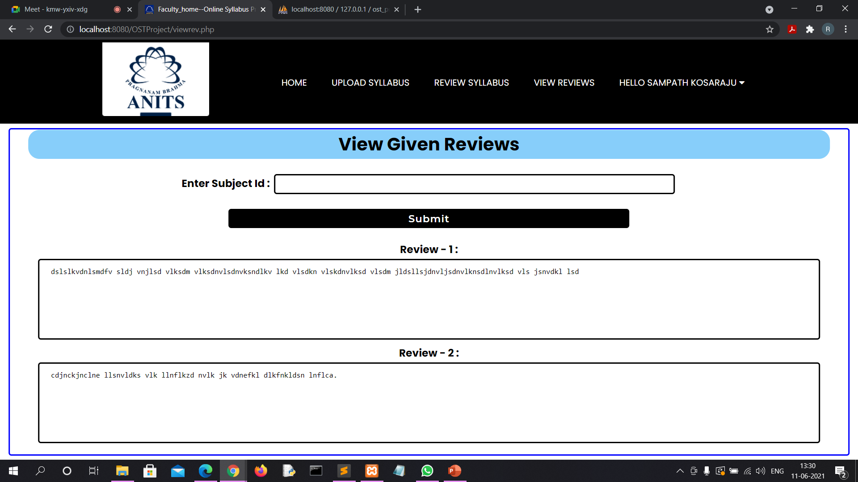

Slide 30
DATABASE AND TABLES

Slide 31
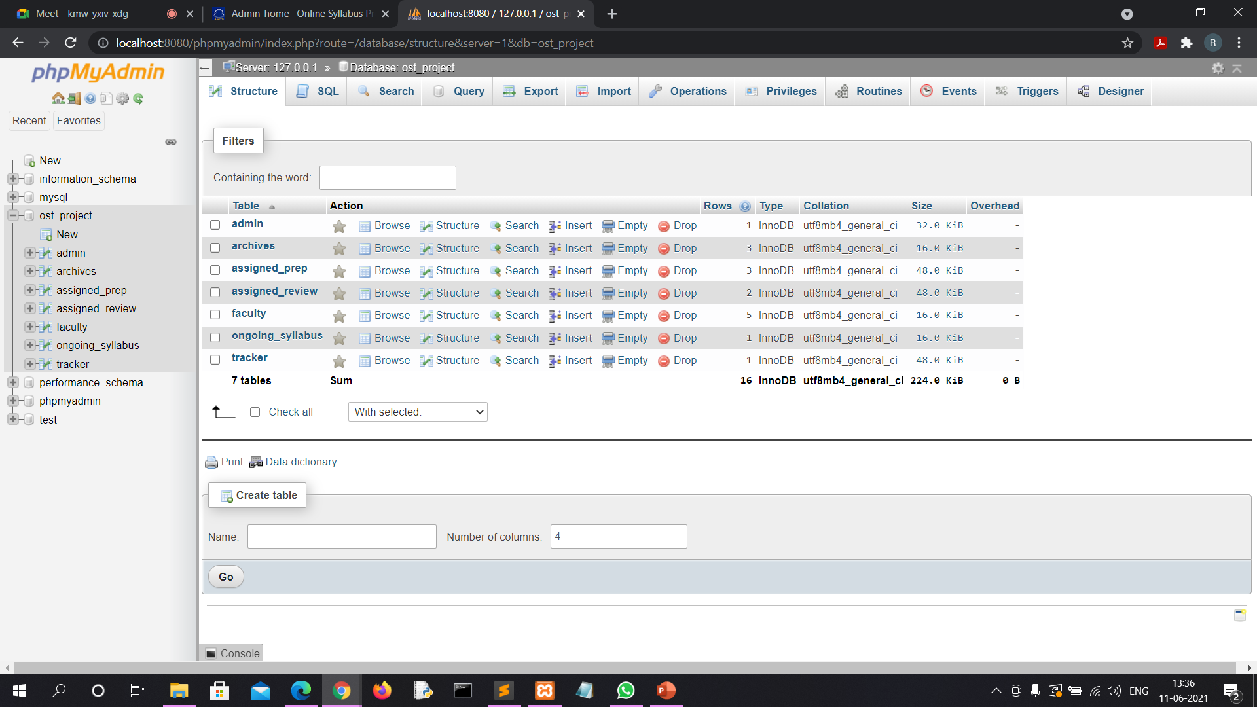

Slide 32
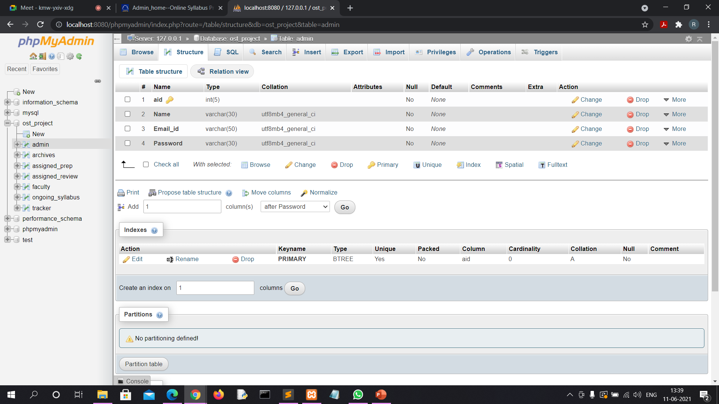

Slide 33


Slide 34
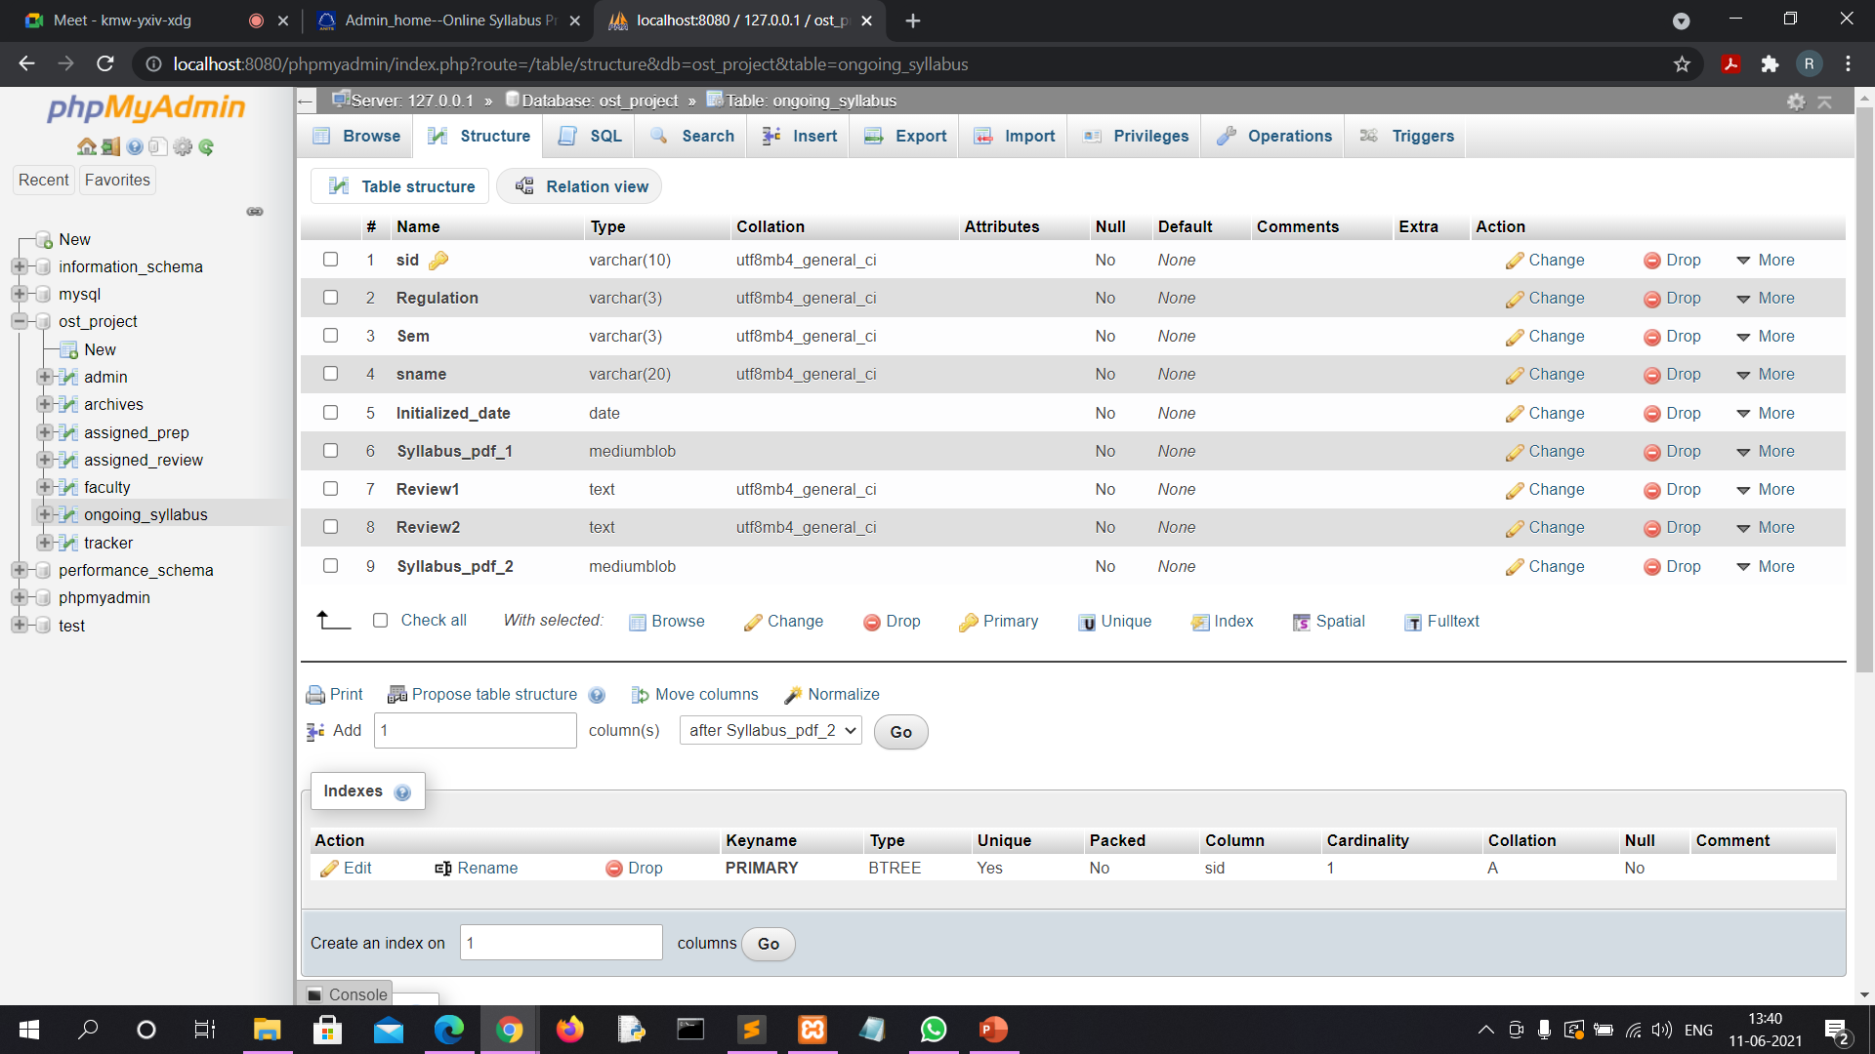

Slide 35
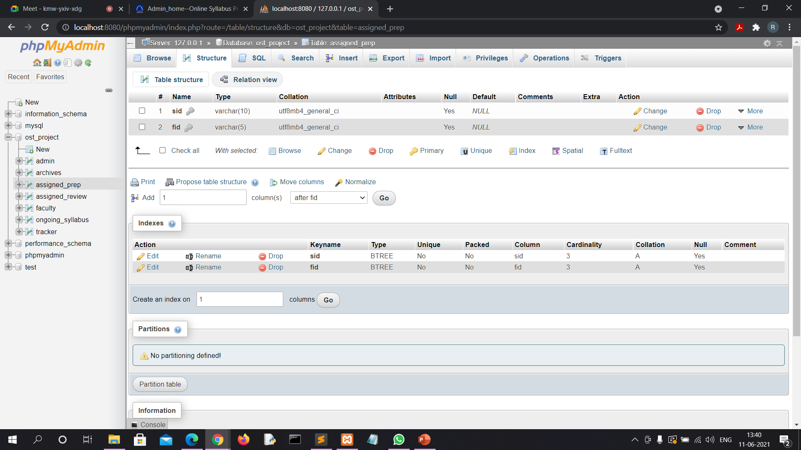

Slide 36
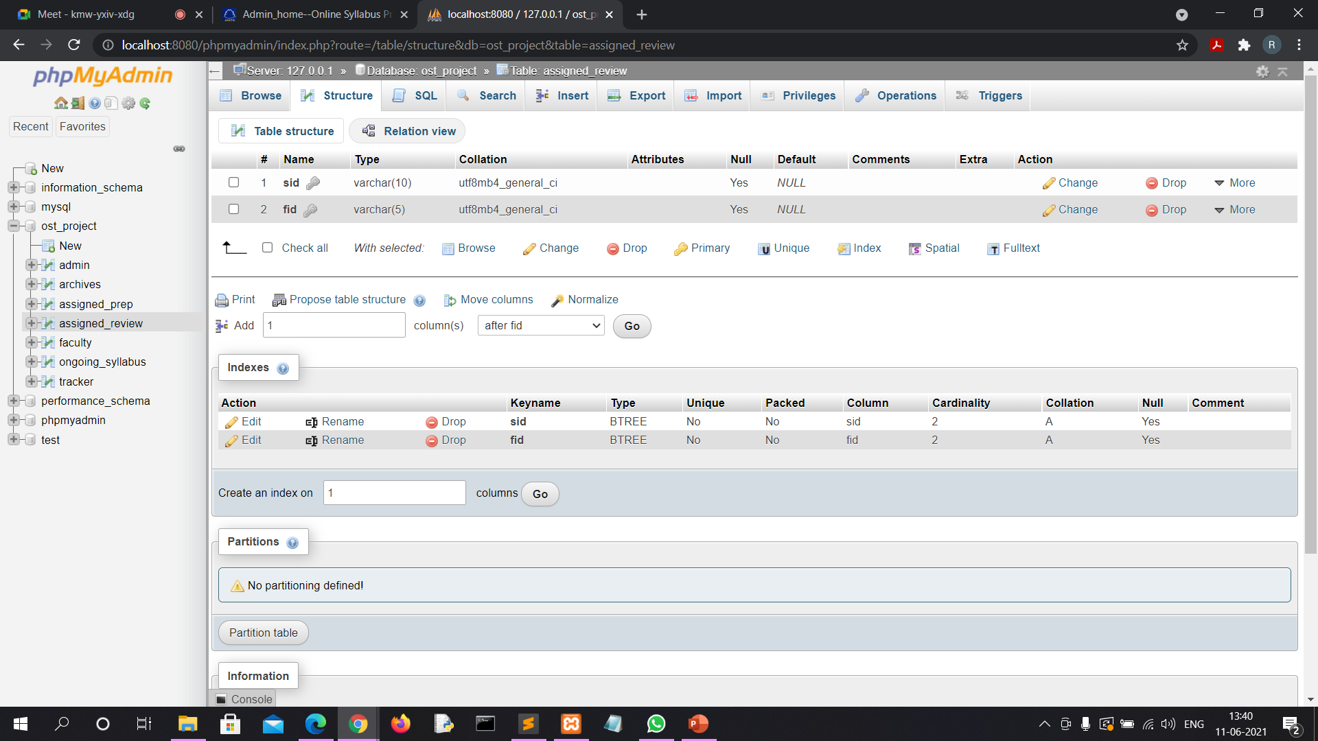

Slide 37
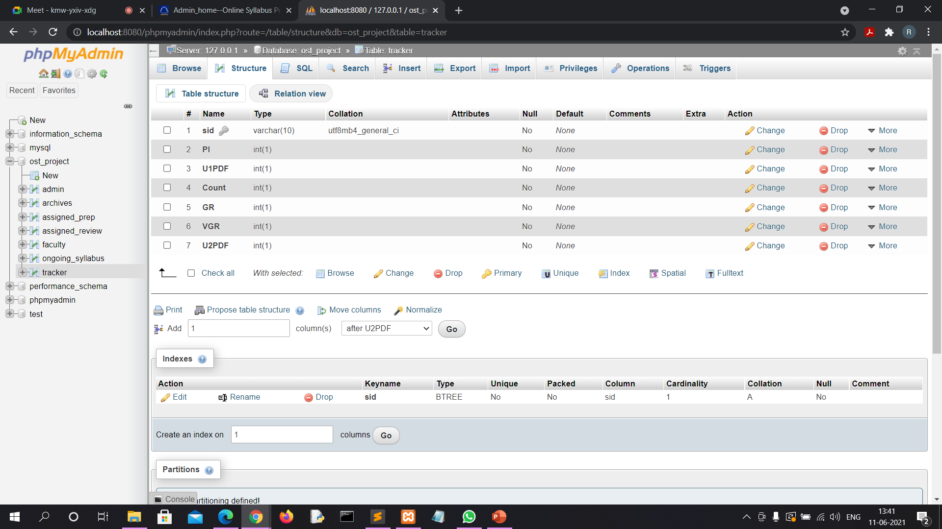

Slide 38
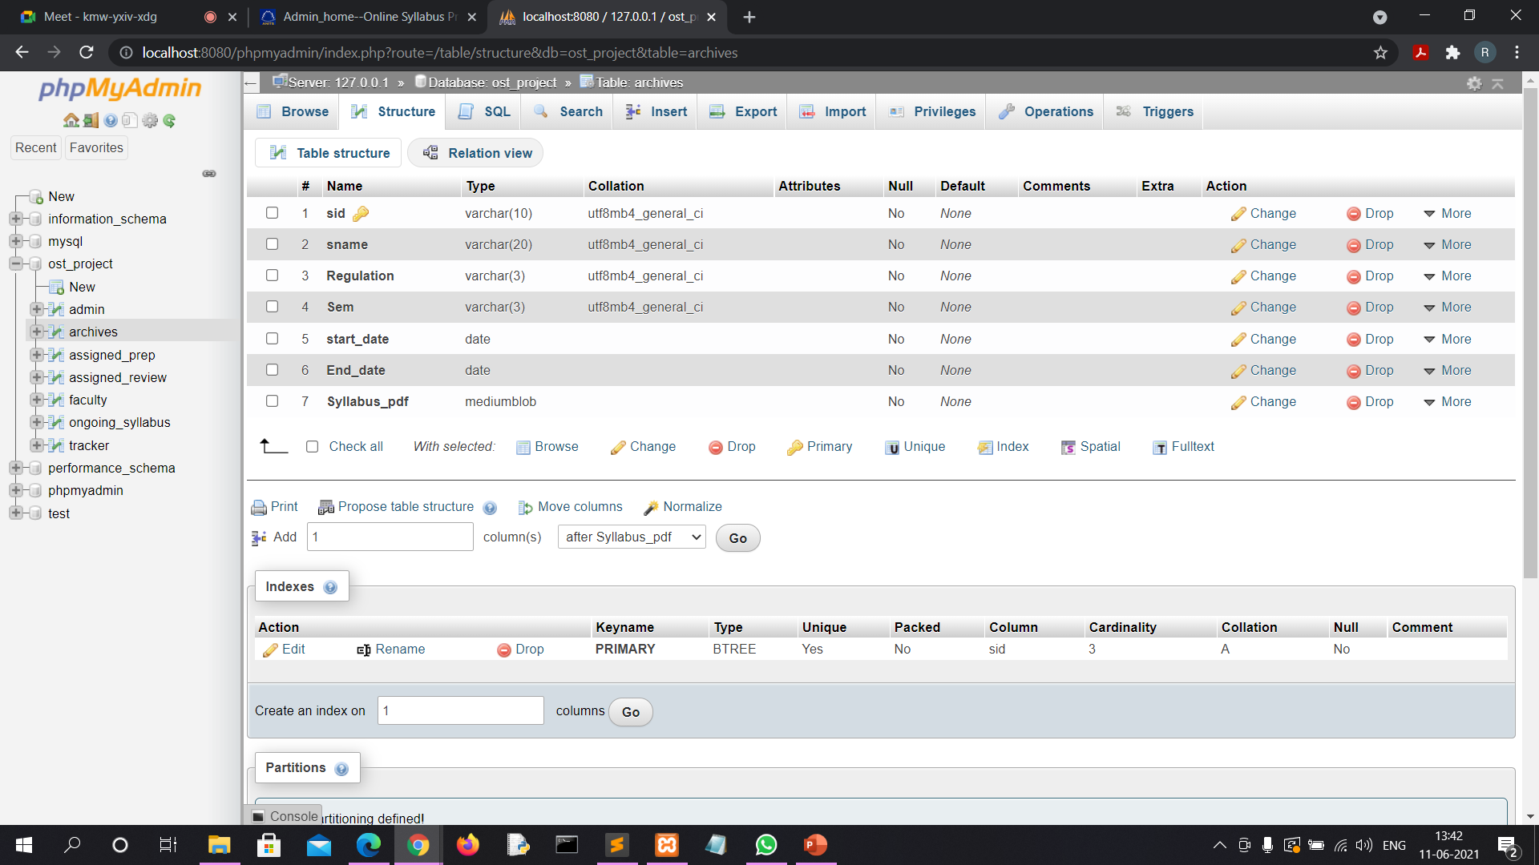

Slide 39
CONCLUSION
The proposed system of Online Syllabus preparation Management System offers all functionalities for the effective syllabus Preparation.It reduces the tedious work of managing syllabus preparation of Syllabus Coordinator.It is highly effective to monitor two or more syllabus preparations in parallel.

